Slide 1



Slide 2
http://ni2.intellisurvey.com/run/celvbasicsquiz

Slide 3

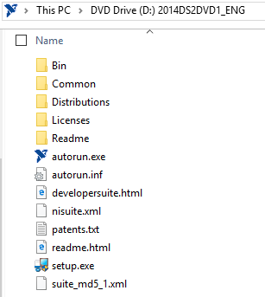
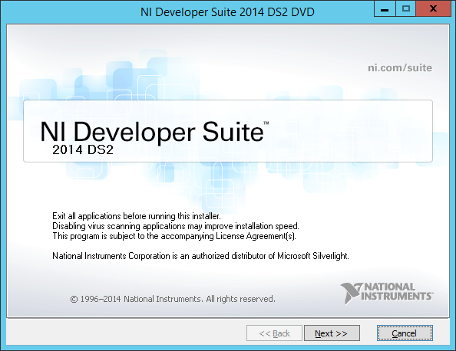
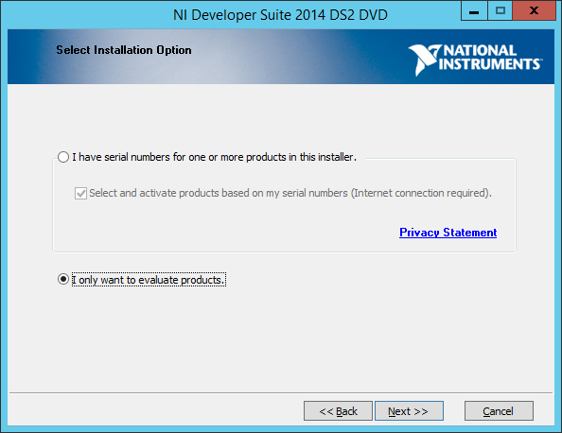
Install labVIEW

Slide 4
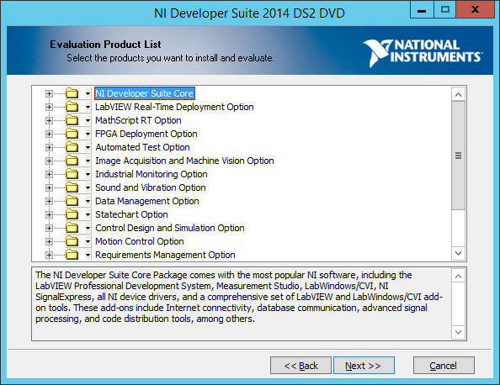
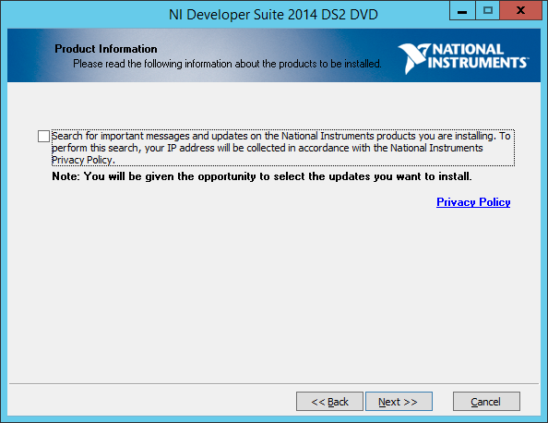

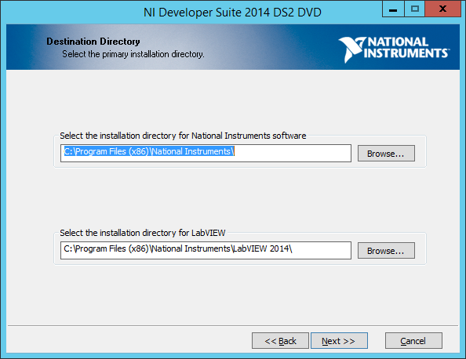
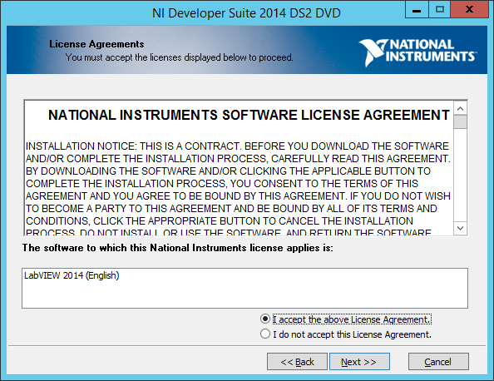
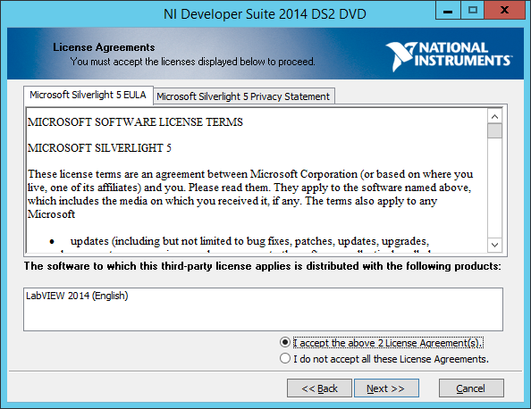

Slide 5
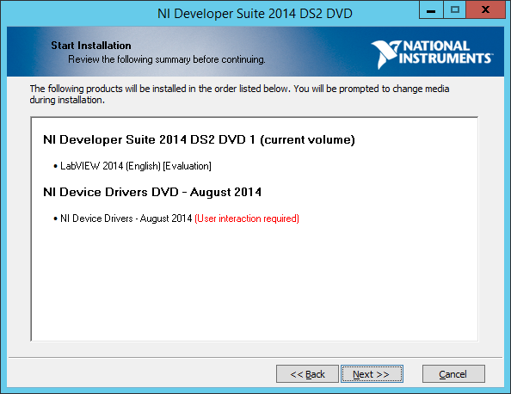
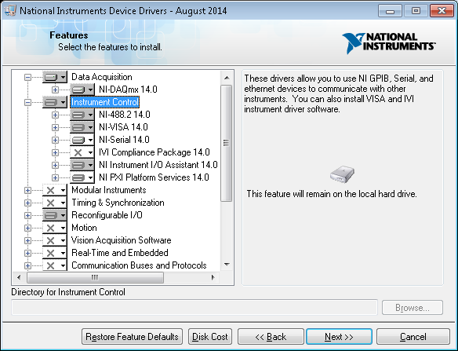

Slide 7
Software Development Method
Define the problem (Scenario)
Design an algorithm or flowchart
Implement the design
Test and verify the implementation
Maintain and update the implementation

Slide 8
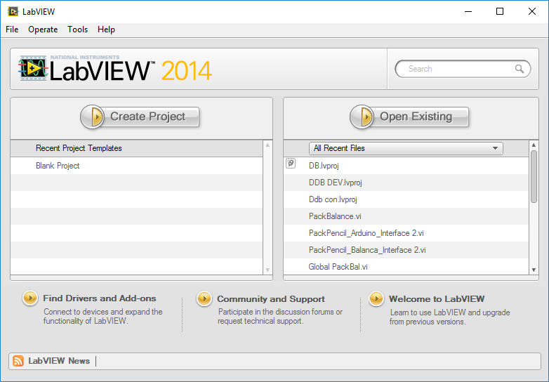
Starting a VI
Select File»New to display the New dialog box, which lists the built-in template VIs
You also can display the New dialog box by selecting the New, VI or Project from Template, or More options on the Getting Started window

Slide 9
Parts of a VI
LabVIEW VIs contain three main components
front panel
block diagram
icon/connector pane

Slide 10
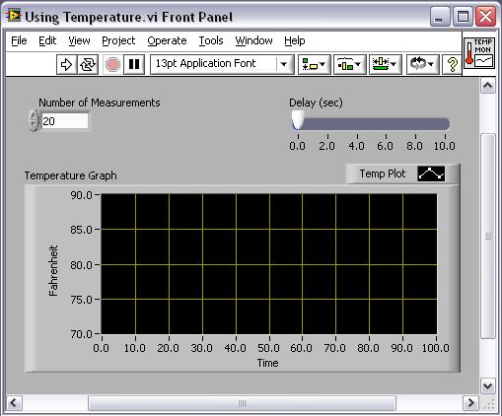
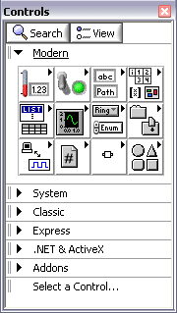
Front Panel
User interface for the VI
You build the front panel with controls (inputs) and indicators (outputs)

Slide 11
Front Panel
Front Panel – Toolbar
Controls & Indicators
Controls
Knobs, push buttons, dials, and other input devices
Simulate instrument input devices and supply data to the block diagram of the VI
Indicators
Graphs, LEDs, and other displays
Simulate instrument output devices and display data the block diagram acquires or generates

Slide 12
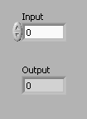
Front Panel
Controls & Indicators
Numeric
The numeric data type can represent numbers of various types, such as integer or real
Numeric Control
Increment/Decrement Buttons
Numeric Indicator

Slide 13

Front Panel
Controls & Indicators
Boolean
The Boolean data type represents data that only has two parts, such as True and False or On and Off
Use Boolean controls and indicators to enter and display Boolean (True or False) values
Boolean objects simulate switches, push buttons, and LEDs
Boolean
Control
Boolean
Indicator

Slide 14
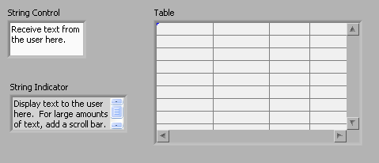
Front Panel
Controls & Indicators
Strings
The string data type is a sequence of ASCII characters
Use string controls to receive text from the user such as a password or user name
Use string indicators to display text to the user

Slide 15
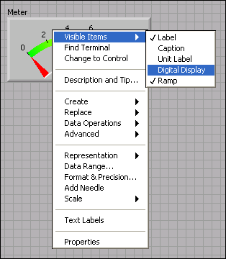
Front Panel
Controls & Indicators
Shortcut Menus
All LabVIEW objects have associated shortcut menus
As you create a VI, use the shortcut menu items to change the look or behavior of front panel and block diagram objects
To access the shortcut menu, right-click the object

Slide 16
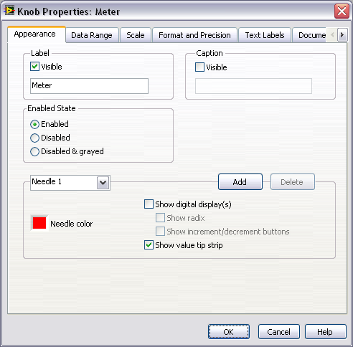
Front Panel
Controls & Indicators
Property Dialog Box
Right-click a front panel object and select Properties to display
The options available on the property dialog box are similar to the options available on the shortcut menu for that object

Slide 17

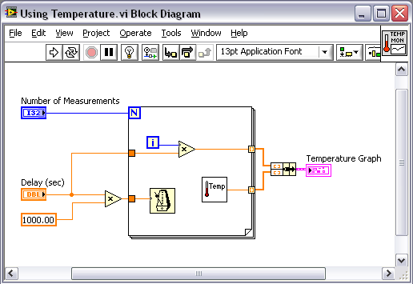
Block Diagram
Contains the graphical source code
Front panel objects appear as terminals on the block diagram

Slide 18
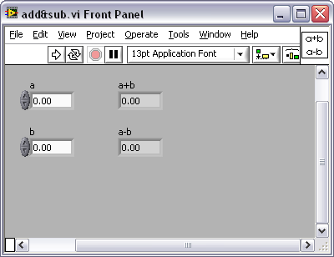
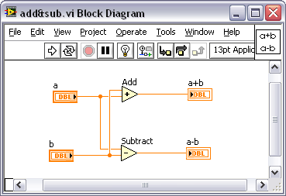
Block Diagram
Block diagram objects include the following:
Terminals
SubVIs
Functions
Constants
Structures
Wires

Slide 19


Block Diagram
Block Diagram – Toolbar
Terminals
Terminals are:
Block diagram appearance of front panel objects
Entry and exit ports that exchange information between the front panel and block diagram
Analogous to parameters and constants in text-based programming languages
Change the view type of a terminal by toggling the View as Icon selection from the right click menu

Slide 20
Block Diagram
Terminals
Nodes
Objects on the block diagram that have inputs and/or outputs and perform operations when a VI runs
Analogous to statements, operators, functions, and subroutines in text-based programming languages
Nodes can be functions, subVIs, or structures

Slide 21
Block Diagram
Terminals
Function Nodes
Fundamental operating elements of LabVIEW
Do not have front panels or block diagrams, but do have connector panes
Double-clicking a function only selects the function – does not open it like a VI
Has a pale yellow background on its icon

Slide 22

Block Diagram
Terminals
SubVI Nodes
VIs that you build to use inside of another VI
Any VI has the potential to be used as a subVI
When you double-click a subVI on the block diagram, you can view the front panel and block diagram of the subVI
The upper right corner of the front panel and block diagram displays the icon for the current VI
This is the icon that appears when you place the VI on a block diagram as a subVI

Slide 23
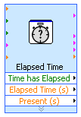
Block Diagram
Terminals
SubVI Nodes
Express VIs are a special type of SubVI
Require minimal wiring because you configure them with dialog boxes
Save the configuration of an Express VI as a subVI
Icons for Express VIs appear on the block diagram as icons surrounded by a blue field

Slide 24



Block Diagram
Terminals
Icons / Explandable Nodes

Slide 25
Block Diagram
Wires
Transfer data between block diagram objects through wires
Wires are different colors, styles, and thicknesses, depending on their data types
A broken wire appears as a dashed black line with a red X in the middle
Broken wire
DBL Numeric Integer Numeric String
Scalar
1D Array
2D Array

Slide 26
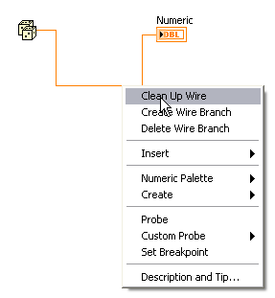

Block Diagram
Wires
Press <Ctrl>-B to delete all broken wires
Right-click and select Clean Up Wire to reroute the wire

Slide 27

Block Diagram
Tools
Create, modify, and debug VIs using the tools
A tool is a special operating mode of the mouse cursor
The operating mode of the cursor corresponds to the icon of the tool selected
When using the Automatic Tool Selection, LabVIEW chooses which tool to select based on the current location of the mouse

Slide 28
Block Diagram
Dataflow
LabVIEW follows a dataflow model for running Vis
A block diagram node executes when it receives all required inputs
When a node executes, it produces output data and passes the data to the next node in the dataflow path
The movement of data through the nodes determines the execution order of the VIs and functions on the block diagram

Slide 29

Block Diagram
Dataflow
A node executes only when data are available at all of its input terminals
A node supplies data to the output terminals only when the node finishes execution

Slide 30
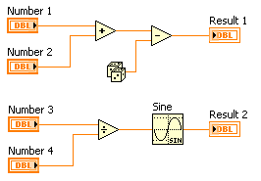
Block Diagram
Dataflow
Quiz
Which node executes first?
Add
Subtract
Random Number
Divide
Sine

Slide 31
Block Diagram
Dataflow
Quiz
Which node executes first?
Add – possibly
Subtract – definitely not
Random Number – possibly
Divide – possibly
Sine – definitely not

Slide 32


Icon / Connector Pane
Icon: graphical representation of a VI
Connector Pane: map of the inputs and outputs of a VI
Icons and connector panes are necessary to use a VI as a subVI
A subVI is a VI that is inside of another VI
Similar to a function in a text-based programming language
Icon Connector Pane

Slide 33
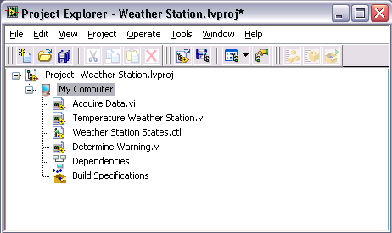
Project Explorer
Use LabVIEW Projects to:
group together LabVIEW files and non-LabVIEW files
create build specifications
deploy or download files to targets
LabVIEW project files (.lvproj) include:
references to files in the project
configuration information
build information
deployment information
etc

Slide 34
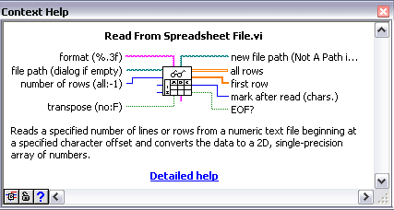
LabVIEW help utilities
Context Help
Displays basic information about LabVIEW objects when you move the cursor over each object
Select Help»Show Context Help, press <Ctrl-H> or click the Show Context Help Window button on the toolbar

Slide 35
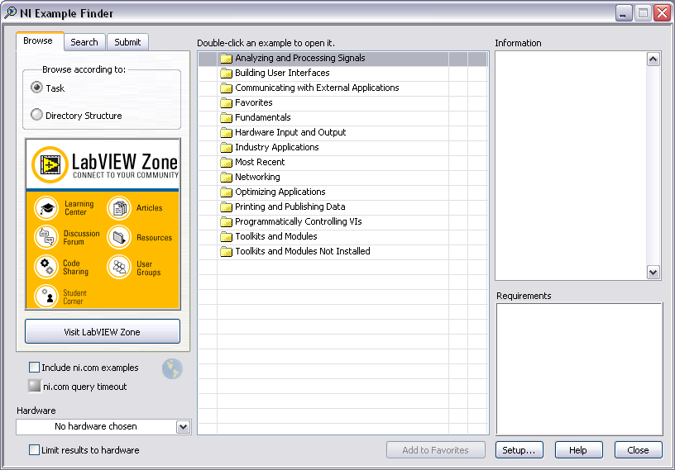
LabVIEW help utilities
LabVIEW Help
Detailed descriptions of most palettes, menus, tools, VIs, and functions
Step-by-step instructions for using LabVIEW features
Accessing the LabVIEW Help:
Click the More Help button in the Context Help window
Select Help»Search the LabVIEW Help
Use the Click here for more help link in the Context Help window
Right-click an object and select Help from the shortcut menu

Slide 36


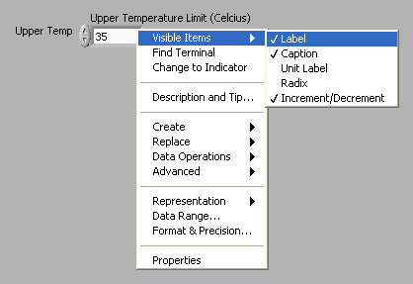
Implementing a VI
Front Panel Design – Labels / Captions
Labels – short descriptions
Captions – long descriptions
Captions do not appear on block diagram

Slide 37
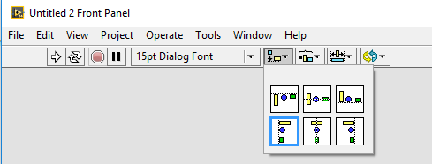
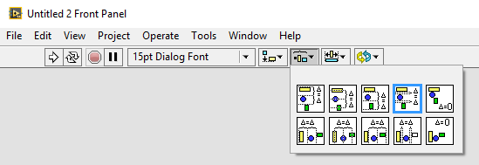
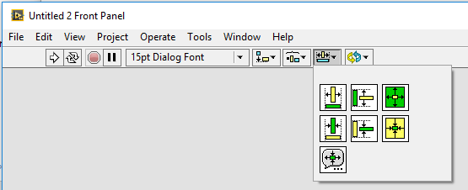
Implementing a VI
Front Panel Design – Spacing, Alignment, Size

Slide 38
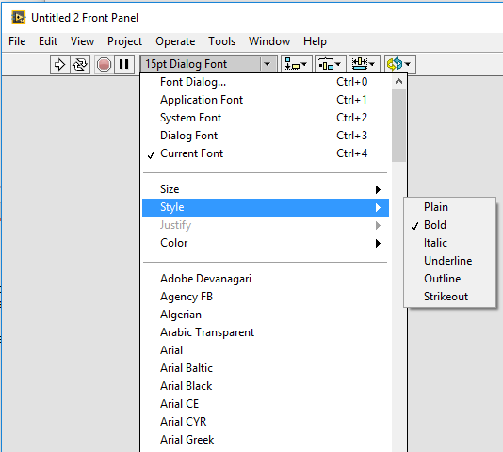
Implementing a VI
Front Panel Design – Text, Fonts

Slide 39
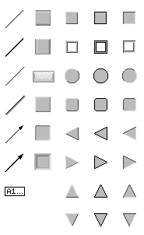
Implementing a VI
Front Panel Design – Decorations
Use decorations to visually group or separate objects on a front panel with boxes, lines, or arrows
These objects are for decoration only and do not display data

Slide 40
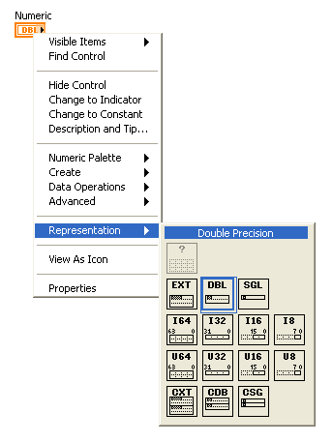
Implementing a VI
Block Diagram Terminals - Numeric
The numeric data type represents numbers of various types
To change the representation of a numeric, right-click the control, indicator, or constant, and select Representation from the shortcut menu

Slide 41
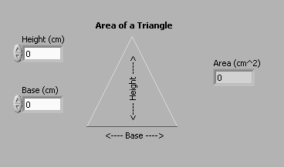
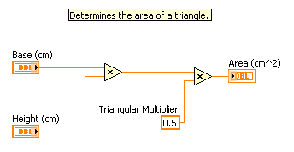
Implementing a VI
Block Diagram Terminals

Slide 42
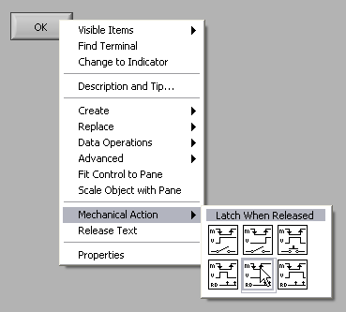
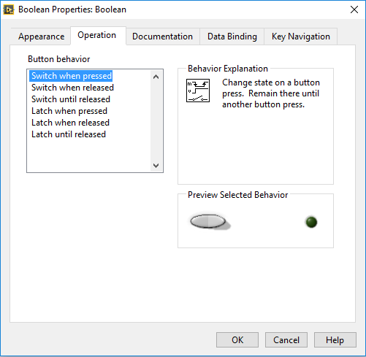
Implementing a VI
Block Diagram Terminals - Boolean
Behavior of Boolean controls is specified by the mechanical action
In LabVIEW, the Boolean
data type is represented
with the color green

Slide 43
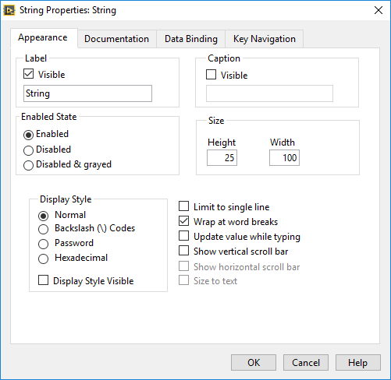
Implementing a VI
Block Diagram Terminals - String
A sequence of displayable or non-displayable ASCII characters
On the front panel, strings appear as tables, text entry boxes, and labels
Change the display type from the short-cut menu: Normal, ‘/’ Codes, Hex and Password
Edit and manipulate strings with the String functions on the block diagram
In LabVIEW, the string data type is represented with the color pink

Slide 44
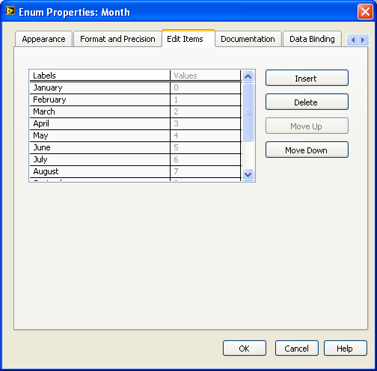
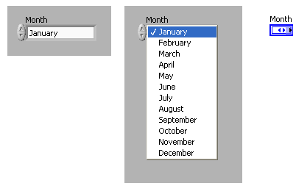
Implementing a VI
Block Diagram Terminals - Enum
An enum represents a pair of values, a string and a numeric, where the enum can be one of a defined list of values
Enums are useful because it is easier to
manipulate numbers than strings
on the block diagram

Slide 45
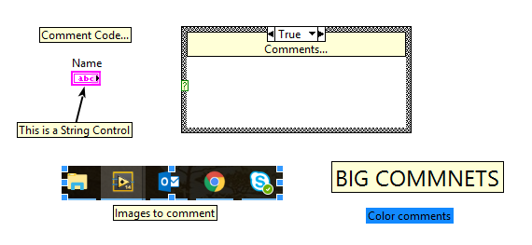
Implementing a VI
Documenting Code
Document the block diagram thoroughly with comments to make it easier to modify code in the future
Describe the purpose of the VI and the front panel objects
Use tip strips, descriptions, VI Properties, and good design to document front panels

Slide 46
Implementing a VI
Documenting Code – Naming
Giving controls and indicators logical and descriptive names adds usability to front panels
For example:
if you name a control Temperature, a user may not know which units to use
If you name a control Temperature °C, the user knows to enter temperature values in metric units

Slide 47
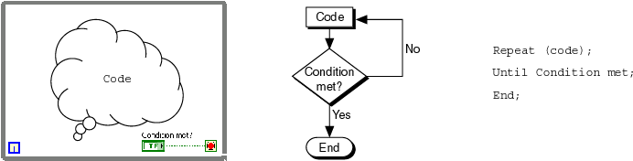
Implementing a VI
While Loops
LabVIEW While Loop Flowchart Pseudo Code
Repeat (code);
Until Condition met;
End;

Slide 48
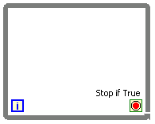

Implementing a VI
While Loops
Iteration terminal: returns number of times loop has executed; zero indexed
Conditional terminal: defines when the loop stops

Slide 49
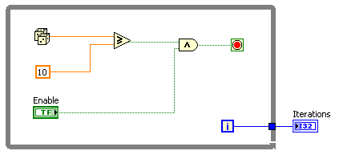
Implementing a VI
While Loops - tunnels
Tunnels transfer data into and out of structures
The tunnel adopts the color of the data type wired to the tunnel
Data pass out of a loop after the loop terminates
When a tunnel passes data into a loop, the loop executes only after data arrive at the tunnel

Slide 50
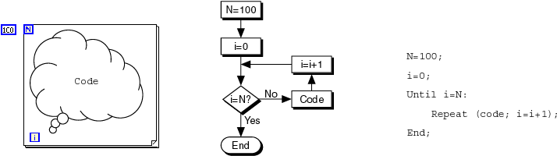
Implementing a VI
For Loops
LabVIEW For Loop Flowchart Pseudo Code
N=100;
i=0;
Until i=N:
Repeat (code;i=i+1);
End;

Slide 51
Implementing a VI
For Loops
Create a For Loop the same way you create a While Loop
If you need to replace an existing While Loop with a For Loop, right-click the border of the While Loop, and select Replace with For Loop from the shortcut menu
The value in the count terminal (an input terminal) indicates how many times to repeat the subdiagram

Slide 52
Implementing a VI
For Loops vs While Loop
For Loop
Executes a set number of times
Can execute zero times
Tunnels automatically output an array of data
While Loop
Stops executing only if the value at the conditional terminal meets the condition
Must execute at least once
Tunnels automatically output the last value

Slide 53
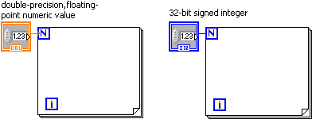
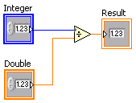
Implementing a VI
For Loops – Numeric Conversion
If you wire a double-precision, floating-point numeric value to the count terminal, LabVIEW converts the larger numeric value to a 32-bit signed integer
A For Loop can only execute an integer number of times
Normally, when you wire different representation types to the inputs of a function, the function returns an output in the larger or wider format
LabVIEW chooses the representation that uses more bits
Coercion Dot

Slide 54
Implementing a VI
Timing a VI
Why do you need timing in a VI?
Control the frequency at which a loop executes
Provide the processor with time to complete other tasks, such as processing the user interface

Slide 55
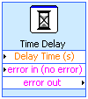


Implementing a VI
Timing a VI – Wait Functions
A wait function inside a loop allows the VI to sleep for a set amount of time
Allows the processor to address other tasks during the wait time
Uses the operating system millisecond clock

Slide 56
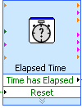
Implementing a VI
Timing a VI – Elapsed Time Express VI
Determines how much time elapses after some point in your VI
Keep track of time while the VI continues to execute
Does not provide the processor with time to complete other tasks

Slide 57
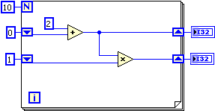
Implementing a VI
Iterative Data Transfer – Shift Registers
Right-click the border and select Add Shift Register from the shortcut menu
Right shift register stores data on completion of an iteration
Left shift register provides stored data at beginning of the next iteration

Slide 58


Implementing a VI
Iterative Data Transfer – Shift Registers
Output = 5
Output = 5
Run once
VI stops execution
Run again
Output = 4
Output = 8

Slide 59



Implementing a VI
Plotting Data – Waveform Chart
Special type of numeric indicator that displays one or more plots of data, typically acquired at a constant rate
Displays single or multiple plots

Slide 60

Implementing a VI
Plotting Data – Chart Update Modes
Right-click the chart and select Advanced»Update Mode from the shortcut menu
Strip chart is the default update mode
Scope chart and Sweep chart modes display plots significantly faster than the strip chart mode

Slide 61



Implementing a VI
Plotting Data – XY Graph
XY graphs display any set of points, evenly sampled or not

Slide 62


Implementing a VI
Case Structures
Has two or more subdiagrams or cases
Displays only one subdiagram at a time
Executes only one case at a time
An input value determines which subdiagram to execute
Similar to case statements or if...then...else statements in text-based programming languages

Slide 63
Implementing a VI
Case Structures
You can specify a default case for the Case structure
If you specified cases for 1, 2, and 3, but you get an input of 4, the Case structure executes the default case
Right-click the Case structure border to add, duplicate, remove, or rearrange cases and to select a default case
You can create multiple input and output tunnels
Inputs are available to all cases if needed
You must define each output tunnel for each case
LabVIEW indicates that at least one output tunnel has not been wired by leaving the center of the tunnel white
When an output tunnel is properly wired in all cases, the output tunnel is a solid color

Slide 64




Implementing a VI
Case Structures
Boolean
String
Boolean input creates two cases: True and False
Add a case for each string as necessary
Strings without a defined case use the default case
Integer
Add a case for each integer as necessary
Integers without a defined case use the default case
Enum
Gives users a list of items from which to select
The case selector displays a case for each item in the enumerated type control

Slide 65

Implementing a VI
Formula Node
Text-based node for performing mathematical operations on the block diagram
Accepts text-based versions of if statements, while loops, for loops, and do loops, which are familiar to C programmers
Allows you to develop complicated equations in a familiar, mathematical environment and then integrate the equations into LabVIEW
Right-click the border of the Formula Node and Select Add Input or Add Output from the shortcut menu to create input and output terminals
Enter the variable for the input or output
Enter the equation in the structure
Terminate each statement with a semicolon (;)

Slide 66







Implementing a VI
Arrays
An array consists of elements and dimensions
Elements: data that make up the array
Dimension: the length, height, or depth of an array
An array can have one or more dimensions and as many as (2³¹)–1 elements per dimension, memory permitting
Consider using arrays when you work with a collection of similar data and when you perform repetitive computations

Slide 67
Implementing a VI
Arrays - Auto-indexing
If you wire an array to or from a For Loop or While Loop, you can link each iteration of the loop to an element in that array by enabling auto-indexing on tunnel
The tunnel changes from a solid square to the image shown above to indicate auto-indexing
Right-click the tunnel and select Enable Indexing or Disable Indexing from the shortcut menu to toggle the state of the tunnel

Slide 68



Implementing a VI
Arrays - Auto-indexing
For Loop executes a number of times equal to the number of elements in the array
When you auto-index an array output tunnel, the output array receives a new element from every iteration of the loop
Therefore, auto-indexed output arrays are always equal in size to the number of iterations
You can use two For Loops, one inside the other, to create a 2D array
The outer For Loop creates the row elements
The inner For Loop creates the column elements

Slide 69


Implementing a VI
Clusters
Clusters group data elements of mixed types
Similar to a record or a struct in text-based programming languages
Clusters differ from arrays in that they are a fixed size
Like an array, a cluster is either a control or an indicator and therefore cannot contain a mixture of controls and indicators

Slide 70





Implementing a VI
Clusters
You can view and modify the cluster order by right-clicking the cluster border and selecting Reorder Controls In Cluster from the shortcut menu
Use the Bundle function to assemble a new cluster
Use the Unbundle By Name or Unbundle function to use individual items in a cluster
Use the Bundle By Name or the Bundle function to modify an existing cluster
LabVIEW uses error clusters to pass error information
Contains the following elements:
status: Boolean value that reports True if an error occurs
code: 32-bit signed integer that identifies the error
source: String that identifies where the error occurred

Slide 71
Implementing a VI
Type Definitions
Use custom controls and indicators to extend the available set of front panel objects
Save a custom control or indicator in a directory or LLB
Use the custom control or indicator on other front panels
Use the Control Editor window to customize controls and indicators
To display the Control Editor window:
Right-click a control or indicator on the front panel and select Advanced»Customize from the shortcut menu,
Use the Positioning tool to select a control or indicator and select Edit»Customize Control
Use the New dialog box

Slide 72
Implementing a VI
Type Definitions
You can save a custom control as a control, a type definition, or a strict type definition
Type definitions are frequently used to define custom arrays, clusters and enumerated data types
Type definitions and strict type definitions link all the instances of a custom control or indicator to a saved custom control or indicator file
You can make changes to all instances of the custom control or indicator by editing only the saved custom control or indicator file

Slide 73

Correcting Broken VIs
Common Issues:
The block diagram contains a broken wire
You wired a Boolean control to a String indicator
You wired a Numeric control to a Numeric control
A required block diagram terminal is unwired
A subVI is broken or you edited its connector pane after you placed its icon on the block diagram of the VI

Slide 74

Debugging Techniques
Execution Highlighting
Use execution highlighting to watch the data flow through the block diagram
If the VI runs more slowly than expected, confirm that you turned off execution highlighting in subVIs

Slide 75
Debugging Techniques
Single Stepping
Single-step through the VI to view each action of the VI on the block diagram
Suspend the execution of a subVI to edit values of controls and indicators, to control the number of times it runs, or to go back to the beginning of the execution of the subVI
Open subVI and select Operate»Suspend When Called from the shortcut menu

Slide 76
Debugging Techniques
Probes
Use the Probe tool to observe intermediate data values and to check the error output of VIs and functions, especially those performing I/O
Retain the values in the wires so that you can probe wires for data after execution has finished

Slide 77
Debugging Techniques
Breakpoints
When you reach a breakpoint during execution, the VI pauses and the Pause button appears red
You can take the following actions at a breakpoint:
Single-step through execution using the single-stepping buttons
Probe wires to check intermediate values
Change values of front panel controls
Click the Pause button to continue running to the next breakpoint or until the VI finishes running

Slide 78
Undefined or Unexpected Data
Undefined data:
NaN (not a number) represents a floating-point value that invalid operations produce, such as taking the square root of a negative number
Inf (infinity) represents a floating-point value that operations produce, such as dividing a number by zero
Floating-point operations propagate NaN and Inf reliably
If NaN or Inf is converted to an integer or Boolean value, the value becomes meaningless
Dividing 1 by zero produces Inf
Converting Inf to a 16-bit integer produces the value 32,767, which appears to be a normal value
Check for NaN by wiring the Comparison function Not A Number/Path/Refnum? to the value you suspect is invalid

Slide 79
Error Checking and Error Handling
No matter how confident you are in the VI you create, you cannot predict every problem a user can encounter
Without a mechanism to check for errors, you know only that the VI does not work properly
Error checking tells you why and where errors occur

Slide 80


Error Checking and Error Handling
Error Clusters
Use the error cluster controls and indicators to create error inputs and outputs in subVIs
The error in and error out clusters include the following components of information:
Status
Code
Source

Slide 81



Error Checking and Error Handling
Error Clusters
Use Case structures inside VIs you build to execute the code if no error, or skip the code if there is an error
Use an error cluster in a While Loop to stop the While Loop if an error occurs

Slide 82


Modularity
SubVis
Modularity defines the degree to which your VI is composed of discrete components such that a change to one component has minimal impact on other components
These components are called modules or subVIs
Modularity increases the readability and reusability of your VIs

Slide 83





Icon and Connector Pane
Use this connector pane layout as a standard
Top terminals are usually reserved for references, such as a file reference
Bottom terminals are usually reserved for error clusters
Terminal Setting
Bold: Required terminal
Plain: Recommended terminals
Dimmed: Optional terminals

Slide 84

Selection to SubVI
Convert a section of a VI into a subVI by using the Positioning tool to select the section of the block diagram you want to reuse and selecting Edit»Create SubVI

Slide 85

Write Data to File

Slide 86
Common Design Techniques
Sequential Programming
State Programming
State Machines
Parallelism

Slide 87


Common Design Techniques
Sequential Programming
There is nothing in this block diagram to force the execution order of these tasks - any one of these tasks could happen first
To force execution order, use a Sequence structure
A structure with frames, where each frame executes in order
The second frame cannot begin execution until everything in the first frame completes execution

Slide 88


Common Design Techniques
Sequential Programming
Avoid overusing Sequence structures
You cannot stop the execution part way through a sequence
The best way to write this VI is to enclose the dialog boxes in Case structures, wiring the error cluster to the case selectors

Slide 89
Common Design Techniques
State Programming
Although a Sequence structure or sequentially wired subVIs accomplish the purpose, it is not always the best choice:
What if you need to change the order of the sequence?
What if you need to repeat one item in the sequence more often than the other items?
What if some items in the sequence execute only when certain conditions are met?
What if you need to stop the program immediately, rather than waiting until the end of the sequence?

Slide 90
Common Design Techniques
State Machines
You can use the state machine design pattern to implement an algorithm that you can explicitly described with a state diagram or flowchart
A state machine consists of a set of states and a transition function that maps to the next state
Each state can lead to one or multiple states or end the process flow

Slide 91




Common Design Techniques
1 - While Loop
2 - Shift Register
3 - Case Structure
State Machines
Components
Default Transition
Transition Between Two States
Case Structure Transition
Transition Array

Slide 92

Common Design Techniques
Parallelism
Passing data among parallel loops is a challenge
How do the loops stop in this example?

Slide 93

Common Design Techniques
Parallelism
How do the loops stop in this example?

Slide 94

Multiple Loop Architectures
Parallel Loop

Slide 95

Multiple Loop Architectures
Master/Slave

Slide 96

Multiple Loop Architectures
Producer / Consumer

Slide 97

Timing a Design Pattern
Explicit Timing
Waiting for Event

Slide 98

Communicating Between Multiple Loops
Local Variables
Use local variables to pass data within a single VI

Slide 99



Communicating Between Multiple Loops
Global Variables
Use global variables to pass data within multiple vi

Slide 100

Communicating Between Multiple Loops
Function Global Variables
The general form of a functional global variable includes an uninitialized shift register with a single iteration For or While Loop

Slide 101


Communicating Between Multiple Loops
Function Global Variables
A functional global variable usually has an action input parameter that specifies which task the VI performs
The VI uses an uninitialized shift register in a While Loop to hold the result of the operation

Slide 102


Communicating Between Multiple Loops
Function Global Variables
Very useful for performing customized elapsed time measurements

Slide 103
Race Condicions
A race condition is a situation where the timing of events or the scheduling of tasks may unintentionally affect an output or data value
Race conditions are a common problem for programs that execute multiple tasks in parallel and share data between the tasks
Race conditions are very difficult to identify and debug
Often, code with a race condition can return the same result thousands of times in testing, but still be capable of returning a different result

Slide 104
Race Condicions
Avoid race conditions by:
Controlling shared resources
Properly sequencing instructions
Identifying and protecting critical sections within your code
Reducing use of variables
Race conditions are most common when two tasks have both read and write access to a resource
A resource is any entity that is shared between the processes; most common resources are shared data storage, such as variables
Minimize shared resources and limit the number of writers to the remaining shared resources
Most race conditions only occur when a resource has multiple writers

Slide 105
Race Condicions
A critical section of code is code that may behave inconsistently if some shared resource is altered while it is running
If one loop interrupts another loop while it is executing critical code, then a race condition can occur
Eliminate race conditions by identifying and protecting critical code with:
Functional Global Variables
Semaphores

Slide 106



Race Condicions
Critical Code
Functional Global Variable used to protect critical code:

Slide 107


Race Condicions
Critical Code

Slide 108

Race Condicions
Sequencing

Slide 109
Synchronizing the Transfer of Data
Variables are one method for passing data between parallel processes
For parallel loops to communicate, you must use some form of globally available shared data
Using variables breaks the LabVIEW dataflow paradigm, allows for race conditions, and incurs more overhead than passing the data by wire

Slide 110
http://ni2.intellisurvey.com/run/celvbasicsquiz

Slide 111


Slide 112
MYSQL
What is Data?
Data can be facts related to any object in consideration.
For example:
Your name, age, height, weight, etc are some data related to you.
A picture , image , file , pdf, etc can also be considered data.

Slide 113
MYSQL
What is a Database?
Is a systematic collection of data.
Support storage and manipulation of data.
Make data management easy.
Example : Facebook. It needs to store, manipulate and present data related to members, their friends, member activities, messages, advertisements and lot more.

Slide 114
MYSQL
Types of DataBase
There are 4 major types of DBMS.
Hierarchical - Its structure is like a tree with nodes representing records and branches representing fields
Network - This type of DB supports many-to many relations, heterogeneous and client/server
Relational - this type of DB defines database relationships in form of tables, also known as relations. Relational DBMS usually have pre-defined data types that they can support
Object Oriented Relation - this type supports storage of new data types. The data to be stored is in form of objects with attributes, and methods that define what to do with the data.

Slide 115
MYSQL
What is SQL?
Structured Query Language (SQL) is the standard language for dealing with Relational Databases.
Relational databases like MySQL Database, Oracle, Ms SQL server, Sybase, etc uses SQL
SQL syntaxes used in these databases are almost similar
Example: SELECT * FROM Members WHERE Age > 30

Slide 116
MYSQL
What is MySQL?
Is an open source relational database.
Supports multiple storage engines each with its own specifications while other systems like SQL server only support a single storage engine.
Has high performance compared to other relation database systems. This is due to its simplicity in design and support for multiple-storage engines.
Cost effective, it's relatively cheaper in terms of cost when compared to other relational databases
Cross platform - MySQL works on many platforms which means it can be deployed on most machines.

Slide 117
MYSQL
Database Design
Database Design is a collection of processes that facilitate the designing, development, implementation and maintenance of enterprise data management systems.
It helps produce database systems
That meet the requirements of the users
Have high performance.
The main objectives of database designing are to produce logical and physical designs models of the proposed database system.
The logical model concentrates on the data requirements and the data to be stored independent of physical considerations. It does not concern itself with how the data will be stored or where it will be stored physically.
The physical data design model involves translating the logical design of the database onto physical media using hardware resources and software systems such as database management systems (DBMS).

Slide 118
MYSQL
Why DB Design is Important ?
Database designing is crucial to high performance database system.
Apart from improving the performance, properly designed database are easy to maintain, improve data consistency and are cost effective in terms of disk storage space.
Note , the genius of a database is in its design . Data operations using SQL is relatively simple

Slide 119

MYSQL
Database development life cycle
Requirements analysis
Planning - This stages concerns with planning of entire Database Development Life Cycle It takes into consideration the Information Systems strategy of the organization.
System definition - This stage defines the scope and boundaries of the proposed database system.
Database designing
Logical model - This stage is concerned with developing a database model based on requirements. (Only on paper)
Physical model - This stage implements the logical model of the database taking into account the DBMS and physical implementation factors.
Implementation
Data conversion and loading - this stage is concerned with importing and converting data from the old system into the new database.
Testing - this stage is concerned with the identification of errors in the newly implemented system .It checks the database against requirement specifications.

Slide 120
MYSQL
Normalization
Normalization is a database design technique which organizes tables in a manner that reduces redundancy and dependency of data.
It divides larger tables to smaller tables and links them using relationships.
Theory of Data Normalization in SQL is still being developed. For example, there are discussions on 6th Normal Form. However, in most practical applications, normalization achieves its best in 3rd Normal Form.

Slide 121

MYSQL
1st Normal Form (1FN)
Each table cell should contain a single value.
Each record needs to be unique.

Slide 122

MYSQL
What is a KEY?
Before we proceed let's understand a few things…
A KEY is a value used to identify a record in a table uniquely.
A KEY could be a single column or combination of multiple columns.
A primary is a single column value used to identify a database record uniquely.
A primary key cannot be NULL
A primary key value must be unique
The primary key values cannot be changed
The primary key must be given a value when a new record is inserted.
A composite key is a primary key composed of multiple columns used to identify a record uniquely

Slide 123


MYSQL
2st Normal Form (2FN)
Rule 1- Be in 1NF
Rule 2- Single Column Primary Key
We have divided our 1NF table into two tables . Table 1 contains member information. Table 2 contains information on movies rented.
We have introduced a new column called Membership_id which is the primary key for table 1. Records can be uniquely identified in Table 1 using membership id

Slide 124

MYSQL – Foreign Key
Foreign Key references the primary key of another Table. It helps connect your Tables
A foreign key can have a different name from its primary key
It ensures rows in one table have corresponding rows in another
Unlike the Primary key, they do not have to be unique.
Foreign keys can be null even though primary keys can not

Slide 125


MYSQL
3rd Normal Form (3FN)
Rule 1- Be in 2NF
Rule 2- Has no transitive functional dependencies
We have again divided our tables and created a new table which stores Salutations.

Slide 126
MYSQL
Create Database, Tables, Data Types
CREATE DATABASE is the SQL command for creating a database.
Imagine you need to create a database with name "movies". You can do it by executing following SQL command.
IF NOT EXISTS let you to instruct MySQL server to check the existence of a database with a similar name prior to creating database.
When IF NOT EXISTS is used database is created only if given name does not conflict with an existing database's name. Without the use of IF NOT EXISTS MySQL throws an error.
You can see list of existing databases by running following SQL command.
CREATE DATABASE movies;
CREATE DATABASEIF NOT EXISTS movies;
SHOW DATABASES

Slide 127

MYSQL
Create Database, Tables, Data Types
CREATE TABLE" is the one responsible for the creation of the table in the database.
"[IF NOT EXISTS]" is optional and only create the table if no matching table name is found.
"`fieldName`" is the name of the field and "data Type" defines the nature of the data to be stored in the field.
"[optional parameters]" additional information about a field such as " AUTO_INCREMENT" , NOT NULL etc
Create Table Example:
Tables can be created using CREATE TABLE statement and it actually
has the following syntax.
CREATE TABLE [IF NOT EXISTS] `TableName` (`fieldname` dataType [optional parameters]) ENGINE = storage Engine;
CREATE TABLE IF NOT EXISTS `MyFlixDB`.`Members` (
`membership_number` INT AUTOINCREMENT ,
`full_names` VARCHAR(150) NOT NULL ,
`gender` VARCHAR(6) ,
`date_of_birth` DATE ,
`physical_address` VARCHAR(255) ,
`postal_address` VARCHAR(255) ,
`contact_number` VARCHAR(75) ,
`email` VARCHAR(255) ,
PRIMARY KEY (`membership_number`) )
ENGINE = InnoDB;

Slide 128
MYSQL
Create Database, Tables, Data Types
Data types define the nature of the data that can be stored in a particular column of a table
MySQL has 3 main categories of data types namely
Numeric,
Text
Date/time.
Numeric Data types
TINYINT( ) | -128 to 127 normal 0 to 255 UNSIGNED.
SMALLINT( ) | -32768 to 32767 normal 0 to 65535 UNSIGNED.
MEDIUMINT( ) | -8388608 to 8388607 normal 0 to 16777215 UNSIGNED.
INT( ) | -2147483648 to 2147483647 normal 0 to 4294967295 UNSIGNED.
BIGINT( ) | -9223372036854775808 to 9223372036854775807 normal 0 to 18446744073709551615 UNSIGNED.
FLOAT | A small approximate number with a floating decimal point.
DOUBLE( , ) | A large number with a floating decimal point.
DECIMAL( , ) | A DOUBLE stored as a string , allowing for a fixed decimal point. Choice for storing currency values.

Slide 129
MYSQL
Create Database, Tables, Data Types
Text Data Types
CHAR( ) | A fixed section from 0 to 255 characters long.
VARCHAR( ) | A variable section from 0 to 255 characters long.
TINYTEXT | A string with a maximum length of 255 characters.
TEXT | A string with a maximum length of 65535 characters.
BLOB | A string with a maximum length of 65535 characters.
MEDIUMTEXT | A string with a maximum length of 16777215 characters.
MEDIUMBLOB | A string with a maximum length of 16777215 characters.
LONGTEXT | A string with a maximum length of 4294967295 characters.
LONGBLOB | A string with a maximum length of 4294967295 characters.

Slide 130
MYSQL – Create Database, Tables, Data Types
Date / Time
DATE | YYYY-MM-DD
DATETIME | YYYY-MM-DD HH:MM:SS
TIMESTAMP | YYYYMMDDHHMMSS
TIME | HH:MM:SS
Apart from above there are some other data types in MySQL.
ENUM | To store text value chosen from a list of predefined text values
SET | This is also used for storing text values chosen from a list of predefined text values. It can have multiple values.
BOOL | Synonym for TINYINT(1), used to store Boolean values
BINARY | Similar to CHAR, difference is texts are stored in binary format.
VARBINARY | Similar to VARCHAR, difference is texts are stored in binary format.

Slide 131
MYSQL
MySQL SELECT
SQL SELECT statement syntax
It is the most frequently used SQL command and has the following general syntax
SELECT is the SQL keyword that lets the database know that you want to retrieve data.
[DISTINCT | ALL] are optional keywords that can be used to fine tune the results returned from the SQL SELECT statement. If nothing is specified then ALL is assumed as the default.
{*| [fieldExpression [AS newName]} at least one part must be specified, "*" selected all the fields from the specified table name, fieldExpression performs some computations on the specified fields such as adding numbers or putting together two string fields into one.
FROM tableName is mandatory and must contain at least one table, multiple tables must be separated using commas or joined using the JOIN keyword.
WHERE condition is optional, it can be used to specify criteria in the result set returned from the query.
GROUP BY is used to put together records that have the same field values.
HAVING condition is used to specify criteria when working using the GROUP BY keyword.
ORDER BY is used to specify the sort order of the result set.
The Star symbol (*) is used to select all the columns in table.
SELECT [DISTINCT|ALL ] { * | [fieldExpression [AS newName]} FROM tableName [alias] [WHERE condition][GROUP BY fieldName(s)] [HAVING condition] ORDER BY fieldName(s)
SELECT * FROM `members`;

Slide 132
MYSQL
Practical examples
The Examples are performed on the following two tables
Table 1: members table
Table 2: movies table
Getting members listing;
Getting only the full_names, gender, physical_address and email fields only.
SELECT * FROM `members`;
SELECT `full_names`,`gender`,`physical_address`, `email` FROM `members`;

Slide 133
MYSQL
Concat()
The Concat () MySQL function is used join the columns values together.
The line "Concat (`title`, ' ', `year_released`) gets the title, adds a space followed by the year released.
Get a list of movie from our database.
We want to have the movie title and the name of the movie director in one field.
The name of the movie director should be in brackets.
We also want to get the year that the movie was released.
SELECT Concat(`title`, ' (', ` year_released `, ')') FROM `movies`;
SELECT Concat(`title`, ' (', `director`, ')') , `year_released` FROM `movies`;

Slide 134
MYSQL
Alias field names
The previous example returned the Concatenation code as the field name for our results. Suppose we want to use a more descriptive field name in our result set. We would use the column alias name to achieve that. The following is the basic syntax for the column alias name
"SELECT ` column_name|value|expression `" is the regular SELECT statement which can be a column name, value or expression.
"[AS]" is the optional keyword before the alias name that denotes the expression, value or field name will be returned as.
"`alias_name`" is the alias name that we want to return in our result set as the field name.
Use the last pratical example using the column alias
SELECT `column_name|value|expression` [AS] `alias_name`;
SELECT Concat(`title`, ' (', `director`, ')') AS 'Concat', `year_released` FROM `movies`;

Slide 135
MYSQL
WHERE Clause
The WHERE clause is used to extract only those records that fulfill a specified condition.
The basic syntax for the WHERE clause when used in a SELECT statement is as follows.
"SELECT * FROM tableName" is the standard SELECT statement
"WHERE" is the keyword that restricts our select query result set and "condition" is the filter to be applied on the results. The filter could be a range, single value or sub query.
Get a member's personal details from members table given the membership number 1
SELECT * FROM tableName WHERE condition;
SELECT * FROM `members` WHERE `membership_number` = 1;

Slide 136
MYSQL
WHERE Clause
Operator | Description
= | Equal
<> | Not equal
> | Greater than
< | Less than
>= | Greater than or equal
<= | Less than or equal
BETWEEN | Between an inclusive range
LIKE | Search for a pattern
IN | To specify multiple possible values for a column

Slide 137
MYSQL
AND , OR
The AND and OR operators are used to filter records based on more than one condition:
The AND operator displays a record if all the conditions separated by AND is TRUE.
The OR operator displays a record if any of the conditions separated by OR is TRUE.
The NOT operator displays a record if the condition(s) is NOT TRUE.
Get a list of all the movies in category 2 that were released in 2008
Get all the movies in either category 1 or category 2
Get all the movies not in category 1
SELECT * FROM `movies` WHERE `category_id` = 2 AND `year_released` = 2008;
SELECT * FROM `movies` WHERE `category_id` = 1 OR `category_id` = 2;
SELECT * FROM `movies` WHERE NOT `category_id` = 1;

Slide 138
MYSQL
IN , NOT
The WHERE clause when used together with the IN keyword only affects the rows whose values matches the list of values provided in the IN keyword.
IN helps reduces number of OR clauses you may have to use
The IN operator allows you to specify multiple values in a WHERE clause.
The IN operator is a shorthand for multiple OR conditions.
The following query gives rows where membership_number is either 1 , 2 or 3
Brain Teaser
Get a list of rented movies that have not been returned on time 24/06/2012. We can use the WHERE clause together with the less than comparison operator and AND logical operator to achieve that.
SELECT * FROM `members` WHERE `membership_number` IN (1,2,3);
SELECT * FROM `movierentals` WHERE `return_date` < '2012-06-25' AND movie_returned = 0;

Slide 139
MYSQL
INSERT
The main goal of database systems is to store data in the tables. The data is usually supplied by application programs that run on top of the database. Towards that end, MYSQL has the INSERT command that is used to store data into a table. The INSERT command creates a new row in the table to store data.
INSERT INTO `table_name` is the command that tells MySQL server to add new row into a table named `table_name`.
(column_1,column_2,...) specifies the columns to be updated in the new row
VALUES (value_1,value_2,...) specifies the values to be added into the new row
When supplying the data values to be inserted into the new table, the following should be considered while dealing with different data types.
String data types - all the string values should be enclosed in single quotes.
Numeric data types - all numeric values should be supplied directly without enclosing them in single or double quotes.
Date data types - enclose date values in single quotes in the format 'YYYY-MM-DD'.
INSERT INTO `table_name`(column_1,column_2,...) VALUES (value_1,value_2,...);

Slide 140
MYSQL
INSERT
Suppose that we have the following list of new library members that need to be added into the database.
INSERT data one by one. Start with Leonard Hofstadter.
Full names | Date of Birth | gender | Physical address | Postal address | Contact number | Email Address
Leonard Hofstadter |  | Male | Woodcrest |  | 0845738767
Sheldon Cooper |  | Male | Woodcrest |  | 0976736763
Rajesh Koothrappali |  | Male | Fairview |  | 0938867763
Leslie Winkle | 14/02/1984 | Male |  |  | 0987636553
Howard Wolowitz | 24/08/1981 | Male | South Park | P.O. Box 4563 | 0987786553 | lwolowitz@email.me
INSERT INTO `members` (`full_names`,`gender`,`physical_address`,`contact_number`) VALUES ('Leonard Hofstadter','Male','Woodcrest',0845738767);

Slide 141


https://store.arduino.cc/arduino-mega-2560-rev3

Slide 142


Slide 143

https://www.arduino.cc/en/Main/Software

Slide 144
FUNCTIONS
For controlling the Arduino board and performing computations.
Digital I/O
digitalRead() digitalWrite() pinMode()
Analog I/O
analogRead() analogReference() analogWrite()
Zero, Due & MKR Family
analogReadResolution() analogWriteResolution()
Advanced I/O
noTone() pulseIn() pulseInLong() shiftIn() shiftOut() tone()
Time
delay() delayMicroseconds() micros() millis()
Math
abs() constrain() map() max() min() pow() sq() sqrt()
Trigonometry
cos() sin() tan()
Characters
isAlpha() isAlphaNumeric() isAscii() isControl() isDigit() isGraph() isHexadecimalDigit() isLowerCase() isPrintable() isPunct() isSpace() isUpperCase() isWhitespace()
Random Numbers
random() randomSeed()
Bits and Bytes
bit() bitClear() bitRead() bitSet() bitWrite() highByte() lowByte()
External Interrupts
attachInterrupt() detachInterrupt()
Interrupts
interrupts() noInterrupts()
Communication
Serial stream
USB
Keyboard Mouse

Slide 145
VARIABLES
Arduino data types and constants.
Constants
Floating Point Constants Integer Constants HIGH | LOW INPUT | OUTPUT | INPUT_PULLUP LED_BUILTIN true | false
Conversion
byte() char() float() int() long() word()
Data Types
String String() array bool boolean byte char double float int long short unsigned char unsigned int unsigned long void word
Variable Scope & Qualifiers
const scope static volatile
Utilities
PROGMEM sizeof()

Slide 146
STRUCTURE
The elements of Arduino (C++) code.
Sketch
loop() setup()
Control Structure
break continue do...while else for goto if...else return switch...case while
Further Syntax
#define (define) #include (include) /* */ (block comment) // (single line comment) ; (semicolon) {} (curly braces)
Arithmetic Operators
% (remainder) * (multiplication) + (addition) - (subtraction) / (division) = (assignment operator)
Comparison Operators
!= (not equal to) < (less than) <= (less than or equal to) == (equal to) > (greater than) >= (greater than or equal to)
Boolean Operators
! (logical not) && (logical and) || (logical or)
Pointer Access Operators
& (reference operator) * (dereference operator)
Bitwise Operators
& (bitwise and) << (bitshift left) >> (bitshift right) ^ (bitwise xor) | (bitwise or) ~ (bitwise not)
Compound Operators
&= (compound bitwise and) *= (compound multiplication) ++ (increment) += (compound addition) -- (decrement) -= (compound subtraction) /= (compound division) ^= (compound bitwise xor) |= (compound bitwise or)

Slide 147






Project
Create a interface collect data from sensor(s) and send to database (ddb)
Use Arduino MEGA as data acquisition
Create a Labview User Interface program to create a Interface from Arduino and database
Create a Labview User Interface program to get data from database

